Slide 1


Slide 2
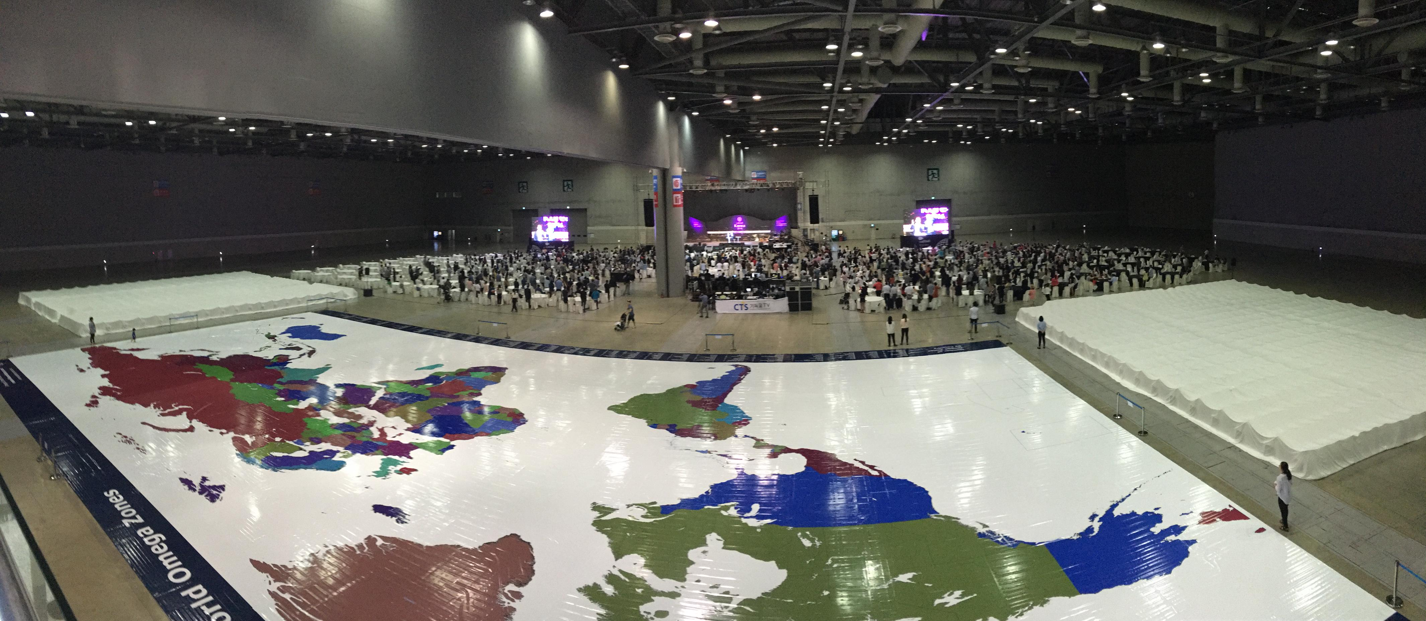

Slide 3
KEY VERSES for our Theme are…
Ephesians 4:22 You were taught, with regard to your former way of life, to put off your old self, which is being corrupted by it’s deceitful desires; 23 to be made new in the attitude of your minds; 24 and to put on the new self, created to be like God in true righteousness and holiness.

Slide 4
Ephesians 1:1–2 (NIV) ¹Paul, an apostle of Christ Jesus by the will of God, To God’s holy people in Ephesus, the faithful in Christ Jesus: ²Grace and peace to you from God our Father and the Lord Jesus Christ.

Slide 5
Application
What are the implications for you in living as a Holy one? (a saint!)
Can your life be described as ‘faithful’?
What does it mean for ‘you’ personally to be in Christ?
Have you experienced and received God’s grace?
Are you at peace with God? (Ephesians 2:14-22)
Are you enjoying and experiencing the peace of God?

Slide 6
Let’s Pray

